Slide 1

Human Reliability Estimation Using Psychophysiological Behaviour: Electroencephalogram Based Brain Signal Analysis Approach
By Abhishek Topwal (21CS60R01)
Under the guidance of Prof. Debasis Samanta

Slide 2
CONTENTS:
Introduction
Objectives
Methodology
EEG Based Experiment
Results and Conclusions

Slide 3
What is HUMAN RELIABILITY?
Reliability of an item is the probability that the item will perform its required function under given conditions for a reference time interval.
definition from:[1]

Slide 4


ITEM
HUMAN

Slide 5
HOW TO FIND HUMAN RELIABILITY ?

Slide 6
Human Reliability Analysis (HRA)
Performance Shaping Factors (PSFs)
Human Error Probability (HEP)

Slide 7
Traditional HRA methods
Questionnaires for the users.
Expert Ratings using the external behavior.
Issues
Highly Subjective in nature.
Affected by biases of the experts.
Lack of inclusion of human cognition.
Recent HRA methods
A cognitive model is simulated by an experiment.
Human specific factors to calculate multipliers for PSFs.

Slide 8
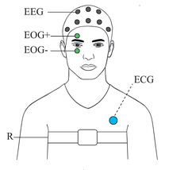
How to incorporate Human Specific Factors
Values ?
Psychophysiological Parameters

Slide 9
Different Psychophysiological Measures:
Electroencephalogram (EEG)
Electromyography (EMG)
ElectroDermal Activity
Cardiovascular Measures
Eye Movements (fixations,gaze)
Notes:
EMG - electrical activity of skeletal muscles electrodermal -changes in electrical conductance of the skin
eye movements - blink rates, eye gaze cognitive interest

Slide 10
Electroencephalography (EEG)
Psychophysiological Parameters affecting Human Reliability
High Temporal Resolution
Provides Real Time data
Reflects Dynamic Nature of the subject
Safe and Portable
Cognitive/Mental Workload
Vigilance
Working Memory
Anxiety
Fatigue
Notes:
mental workload - amount of resources required to perform a set of concurrent tasks
vigilance - sustained concentration
working memory- small amount of info that can be held in mind
anxiety- emotion that perisit even after stressful situation is over
fatigue - results form exertion or prolonged stress
psychophysiological factors act as PSFs

Slide 11
Performance Shaping Factors (PSFs)
Mental Workload
Anxiety

Slide 12


Mental Workload + Anxiety
PSPHERE
HUMAN ERROR PROBABILITY
Subject
EEG

Slide 13

OBJECTIVES

Slide 14
Experiment Identification
Evoke various levels of Mental Workload and Anxiety in the subject.
Subject must handle and respond to multiple attributes.
Difficulty of tasks can be moderated.
Psychophysiological Parameters Estimation
Collection and Preprocessing of Data.
Generate the feature vector.
Classify into different levels of Mental Workload and Anxiety.
Human Error Probability (HEP) estimation
Find the transition and state probability matrices.
Finding multipliers for the considered PSFs.
Calculate HEP values using the Multipliers.

Slide 15

METHODOLOGY

Slide 16
PROBLEMS ADDRESSED
Eliciting emotions
2. Psychophysiological parameters
3. PSFs multipliers
Notes:
PSFs: Either domain-dependent and/or expert-determined

Slide 17

EXPERIMENT DESIGN

Slide 18
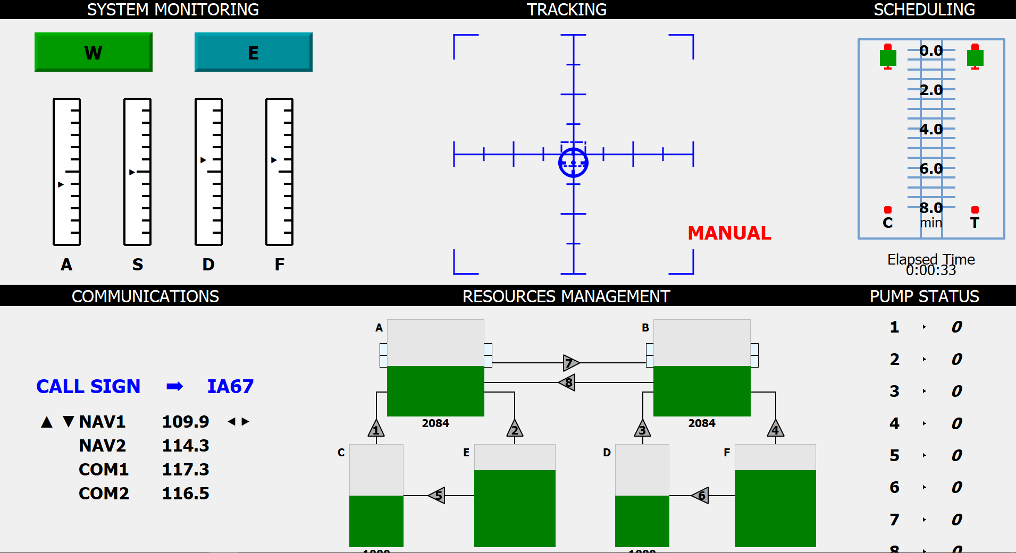
MULTIPLE ATTRIBUTE TASK BATTERY
Notes:
aircraft tasks simulator designed to evaluate operator performance and workload
requires the users to perform various tasks at the same time testing the mental workload and situation handling of the subject.
The MATB requires the subject to simultaneously perform tasks related to monitoring, resource allocation,
The original implementation uses joystick and keyboard to manipulate the tasks andgenerate responses

Slide 19
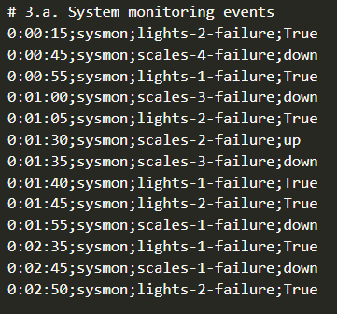
Scenario Settings
Notes:
Scenario Settings - introduction

Slide 20
Along what
points to build
the Scenario files?

Slide 21
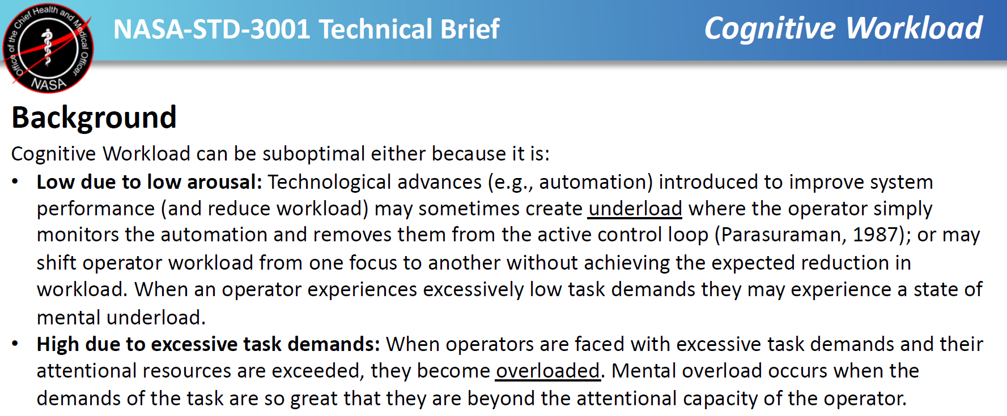
Screenshot taken from:[2]

Slide 22
Mental Workload | Level | Defintion
 | Low | Task automation and monitoring Less Effort Minimum Difficulty
 | Medium | Optimum Performance Less Error
 | High | Excessive Task Demands More Errors
Anxiety | Level | Defintion
 | Low | Well aroused No errors
 | High | Nervous Indecisive More Errors

Slide 23
PILOT STUDY
Objectives of Pilot Study
To build the ground truth/label for the scenario settings.
Notes:
i.e to find the corresponding levels of PSFs Mental Workload and Anxiety w.r.t the setting.

Slide 24
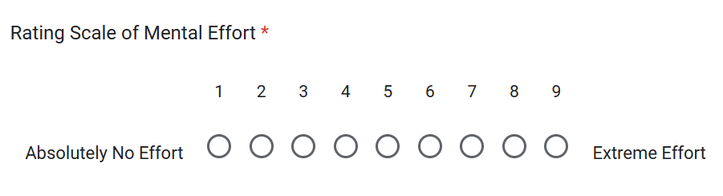
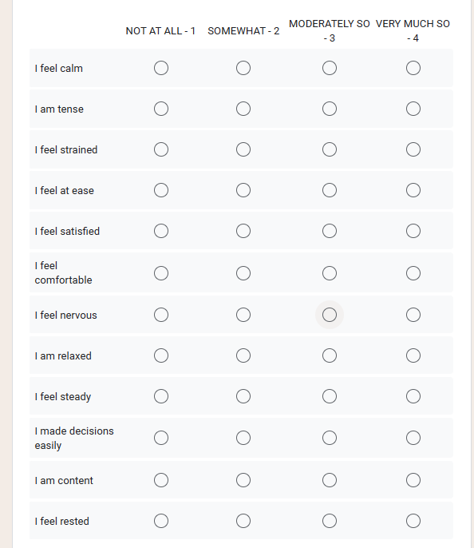
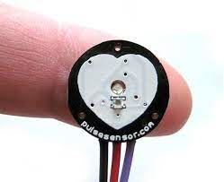
Subjective Anxiety Questionnaire
Pulse Sensor to measure BPM

Slide 25

Pilot Study Session
Collect Basic Data and Assign a 5-digit ID
Demo Session of OpenMATB
Session 1
Questionnaire
Session 2
Questionnaire
3 Minutes
3 Minutes

Slide 26
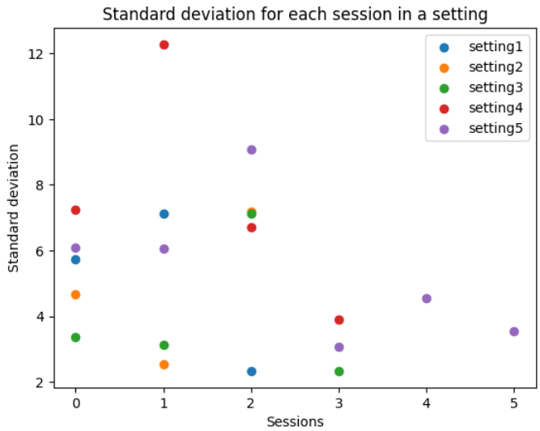

Slide 27
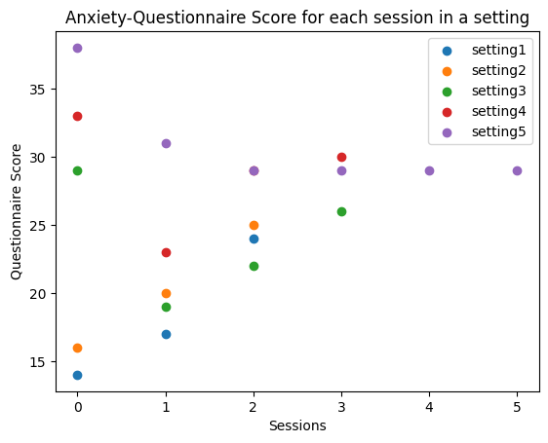

Slide 28
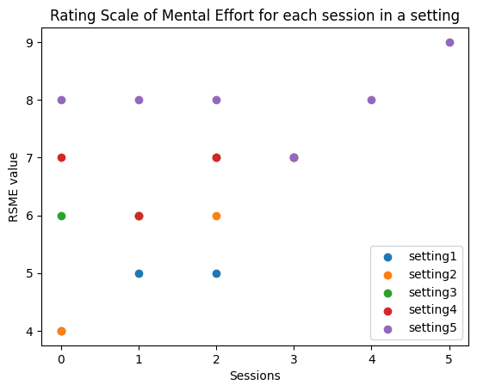

Slide 29
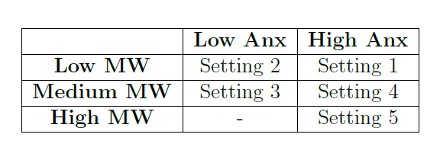

Slide 30
Mental Workload and Anxiety Estimation

Slide 31
Collect EEG Data
Preprocess Data
Construct a Feature Vector w.r.t the paramter

Slide 32
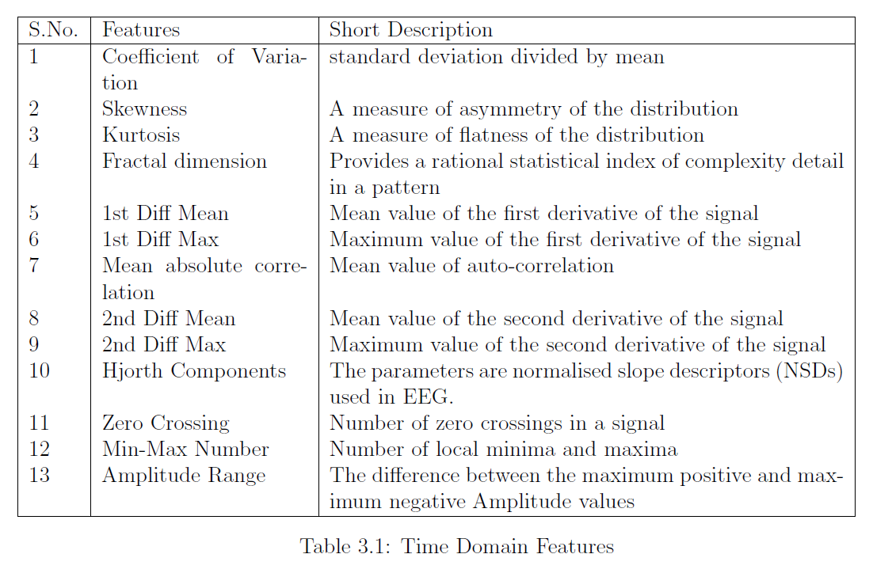
Time Domain Features

Slide 33
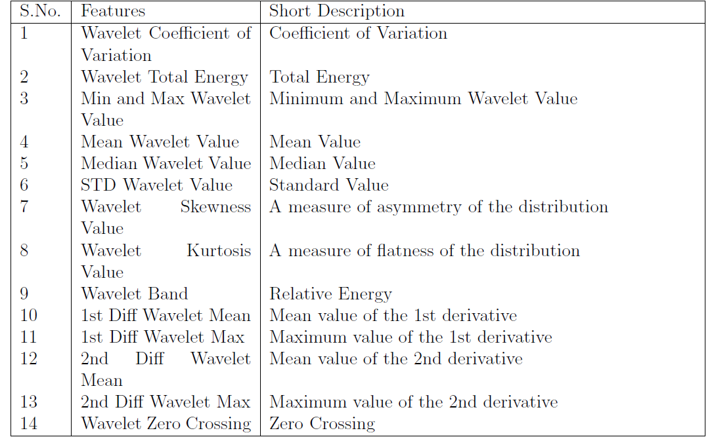
Wavelet Features

Slide 34
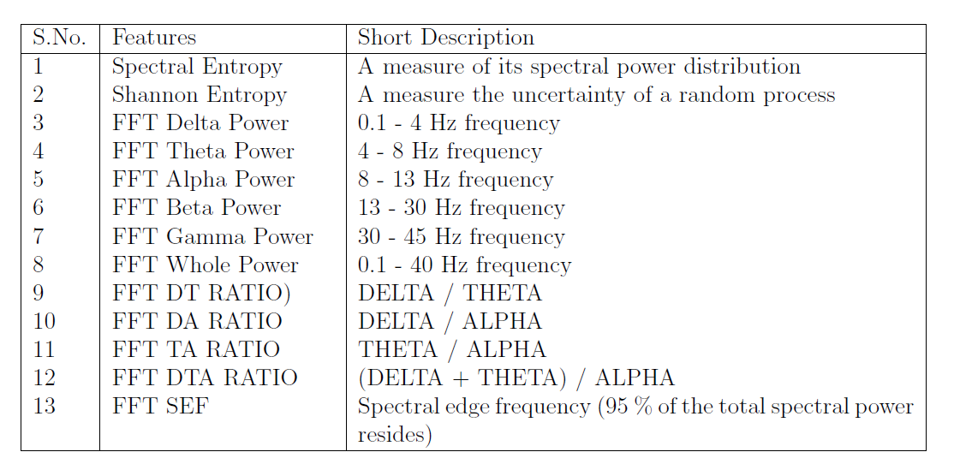
Frequency Domain Features

Slide 35
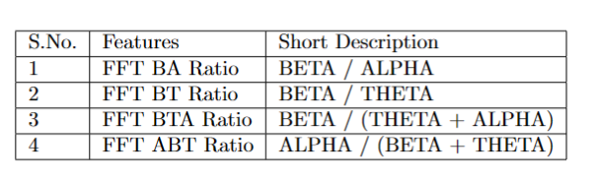

Slide 36
Machine Learning Models
K-Nearest Neighbors (KNN)
Support Vector Machines (SVM)
Decision Tree
Random Forest
Linear Discriminant Analysis (LDA)

Slide 37
Human Error Probability Calculation

Slide 38
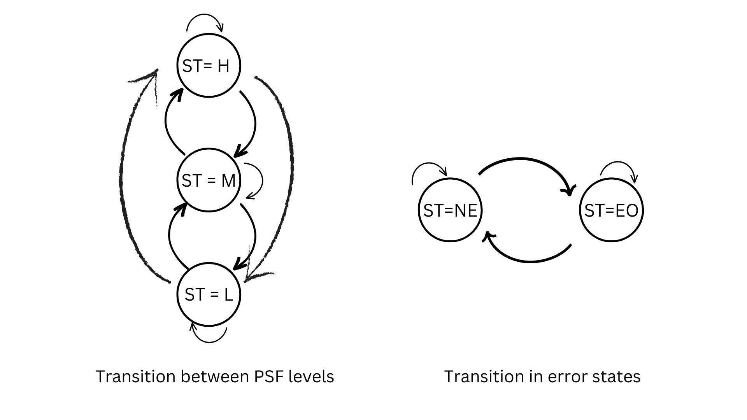
Multiplier Evaluation for the considered PSFs[3]
Continuous Time Markov Chain (CTMC) Model
Notes:
The CTMC model is applied to random processes which exist in discrete
state space but can change their values at any instant of time. Also, the future state
of the model depend only on the current state and not on the previous states. The
CTMC model imitate the highly dynamic nature of humans as the state of a person
can make transition from any state to the other at any instant of time. The model
also reflects the human behaviour in a way that it his highly correlated to the present
state and not on the history of the states to reach the current state

Slide 39
Multiplier Evaluation for the considered PSFs
• Evaluate the probability of being in a defined PSF level.
• Evaluate the probability of the error in that state.

Slide 40
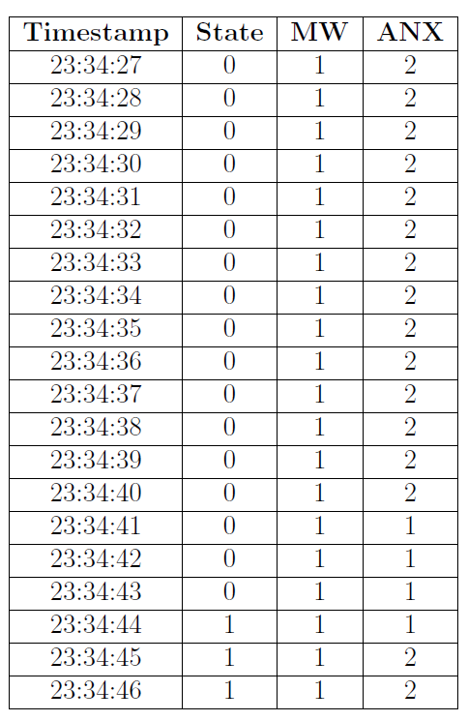
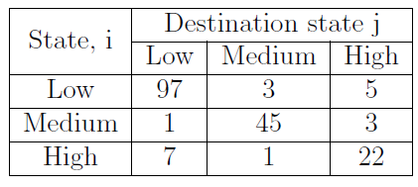
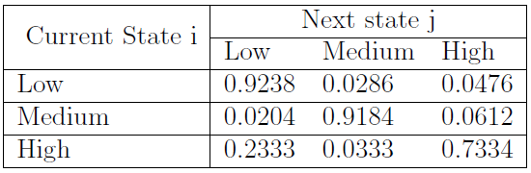

Slide 41
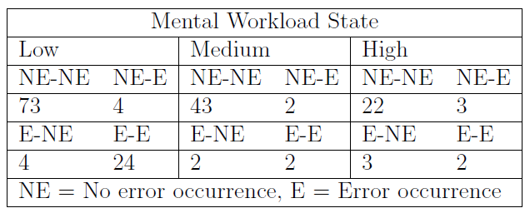
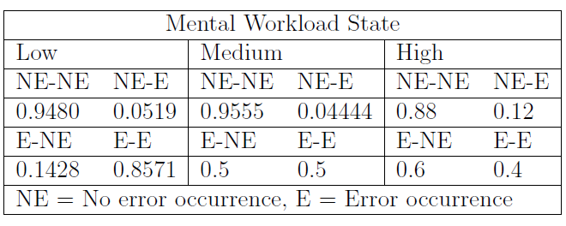

Slide 42
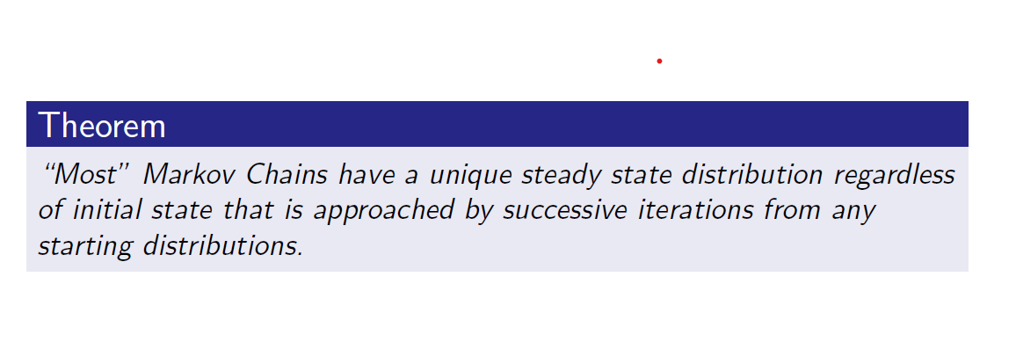
Screenshot taken from: [4]

Slide 43
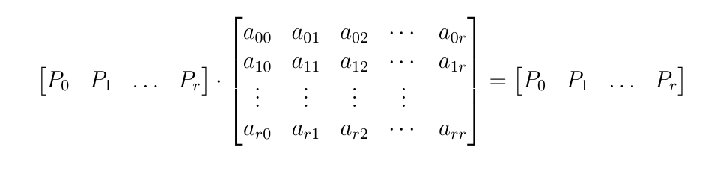
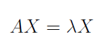
Steady State Probabilities Computation

Slide 44
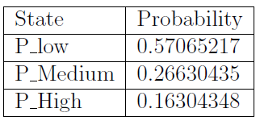
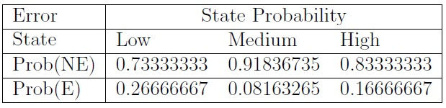

Slide 45
Human Error Probability Calculation
Hence, the steps are:
Evaluate the Multipliers for all the considered PSFs.
2. Perform product of all the multipliers to get the error contribution from the factors. HEP = P(MW) * P(A)

Slide 46
EEG Based Experiment

Slide 47
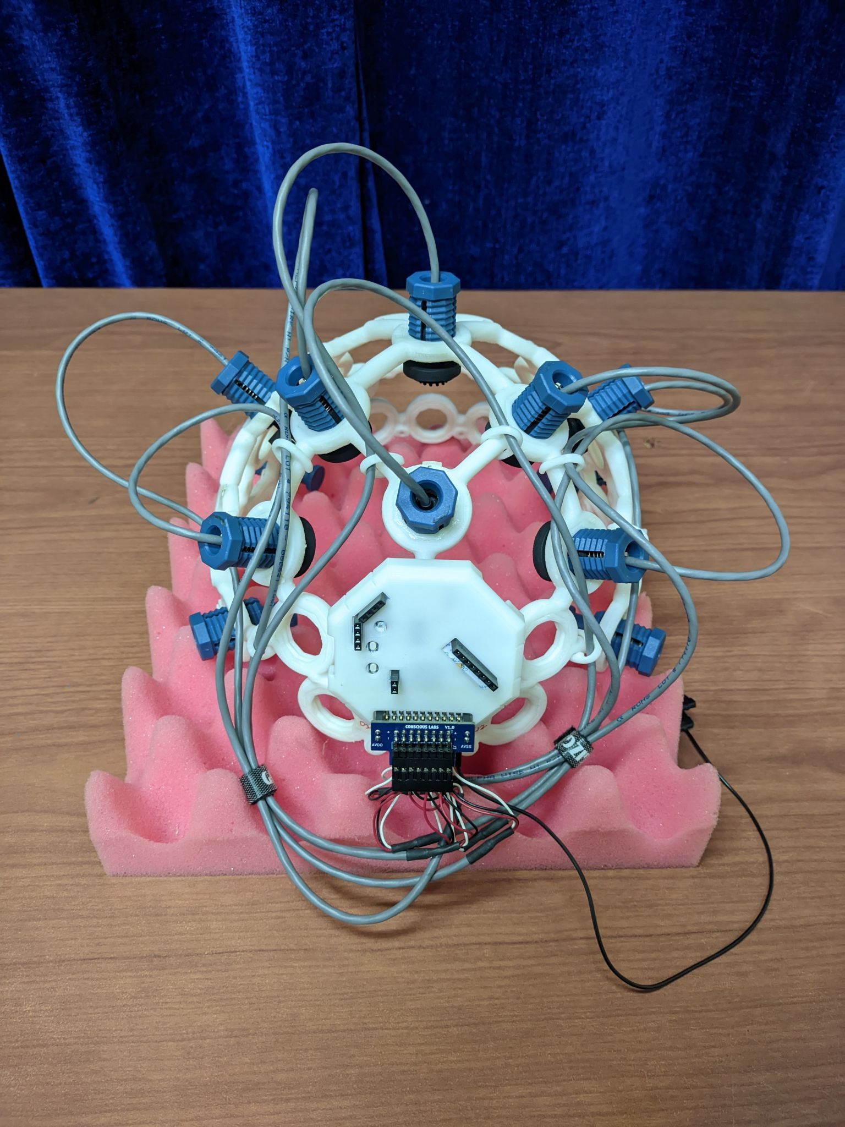
APPARATUS
8 Channels ULTRACORTEX ”MARK IV” EEG HEADSET
ThinkPulse dry and active electrodes and the Cyton board
interfaced through the OpenBCI GUI application
The streaming rate is 250Hz.

Slide 48
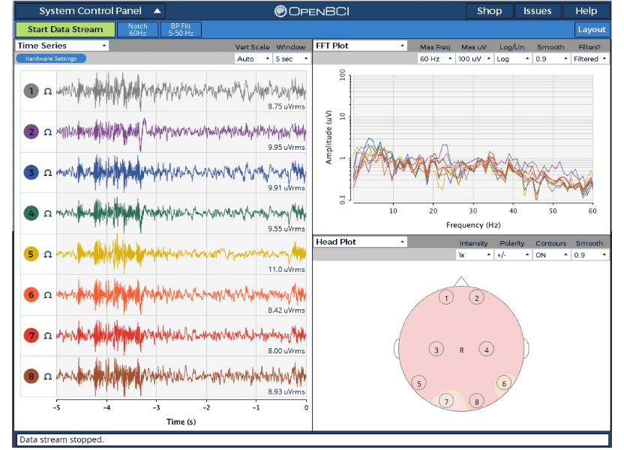

Slide 49
Experiment Session
Demo Session of OpenMATB
Session 1
Break
Session 2
EEG
3 Minutes
1 Minute
3 Minutes

Slide 50
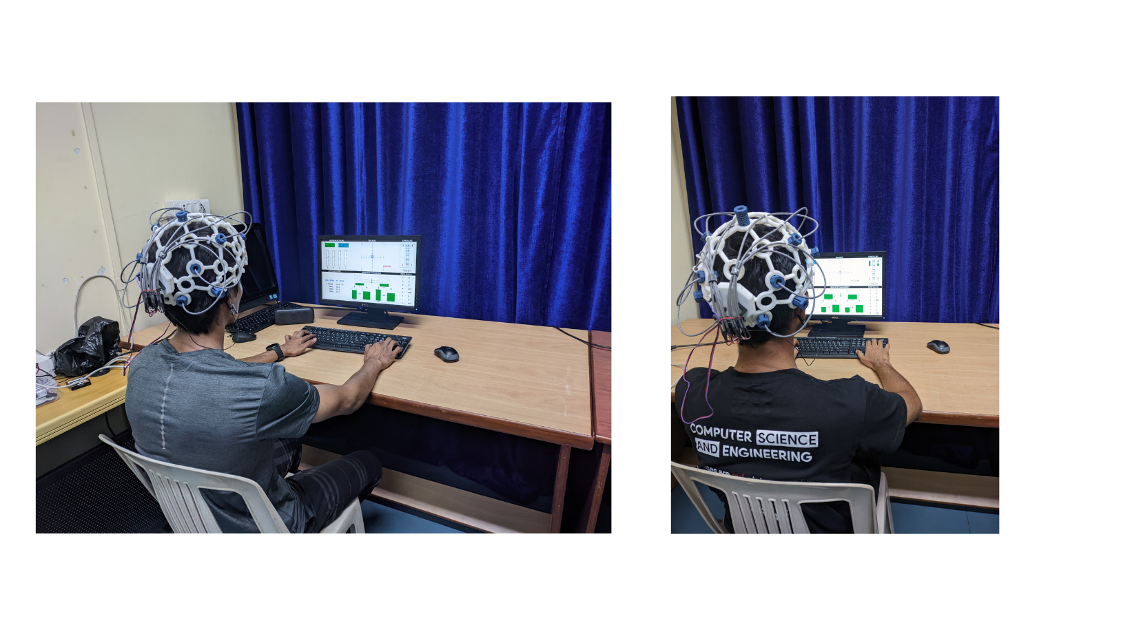

Slide 51
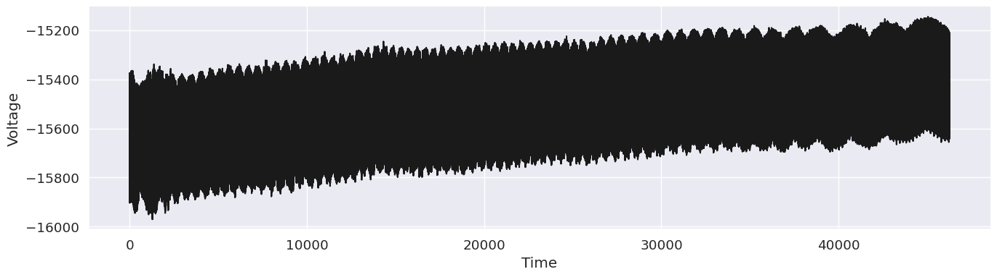
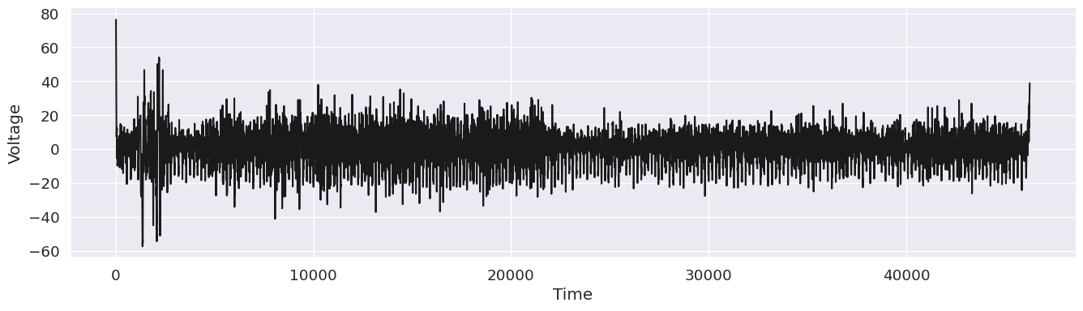
Preprocessing Data
Outside session data is removed
Notch filter : 50Hz.
Band-pass filter: 1-45 Hz
Artifact Subspace Reconstruction (ASR) to reject signal segments containing motion artifacts.

Slide 52
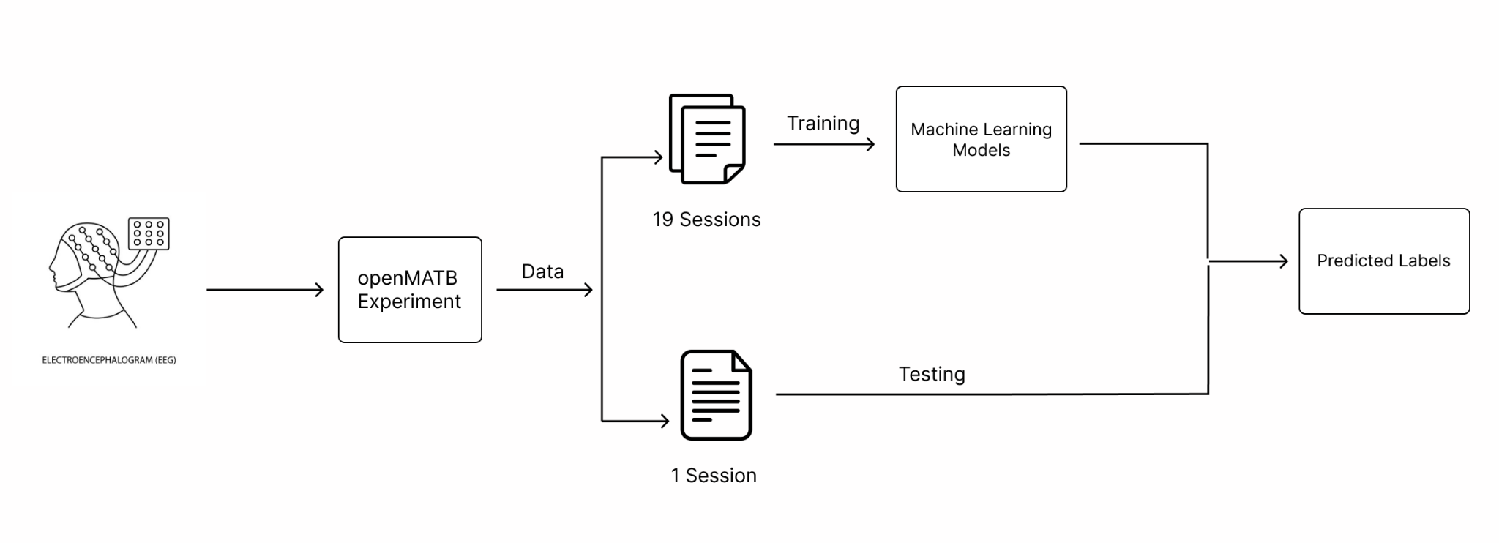

Slide 53
RESULTS

Slide 54
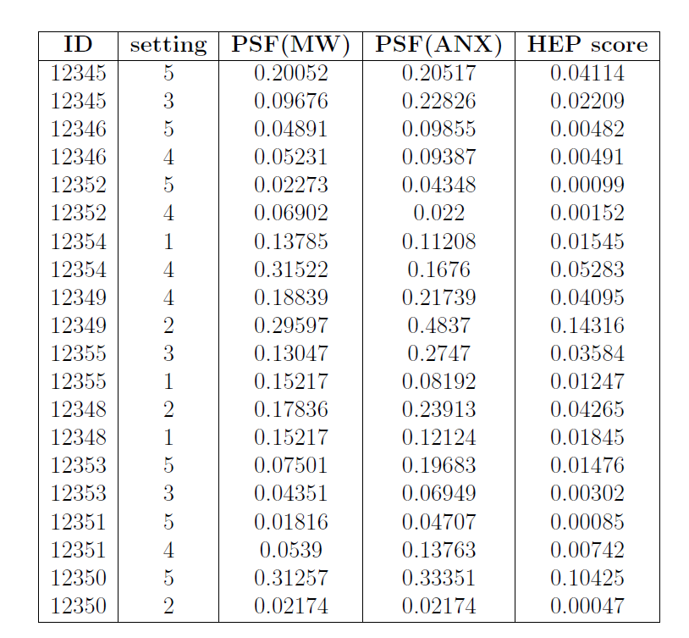

Slide 55
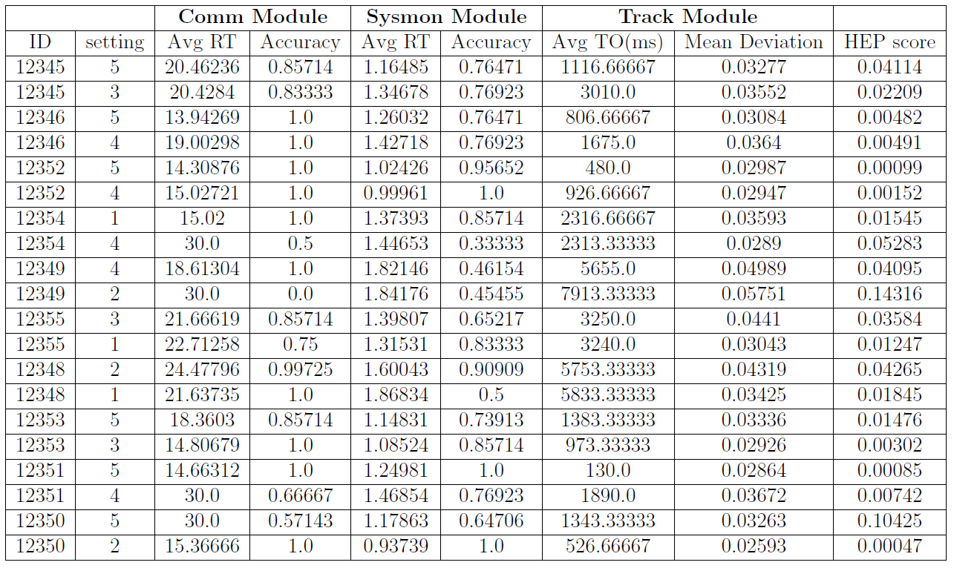

Slide 56
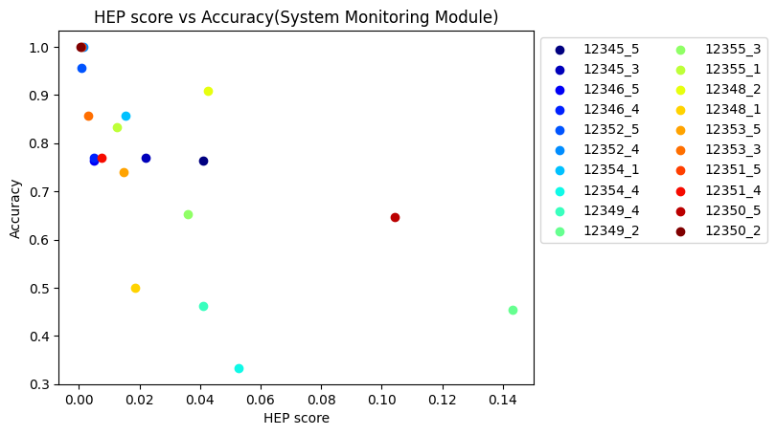

Slide 57
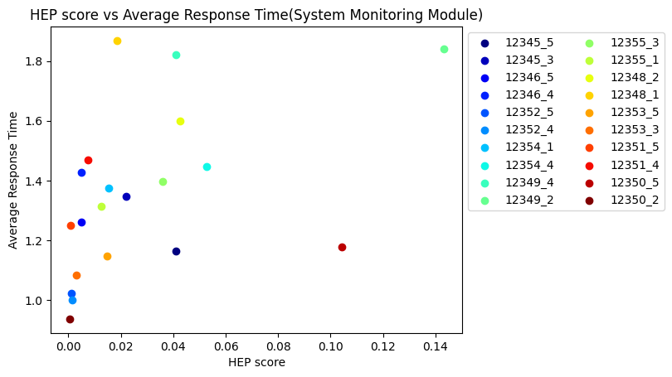

Slide 58
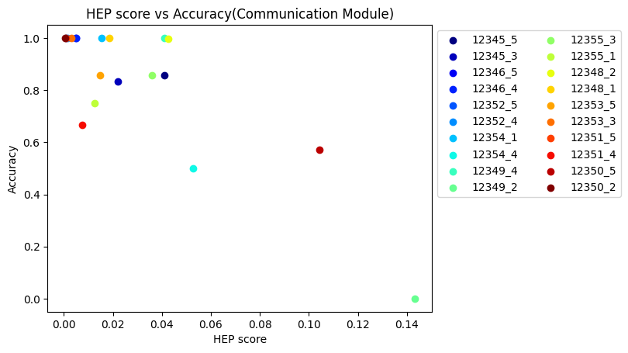

Slide 59
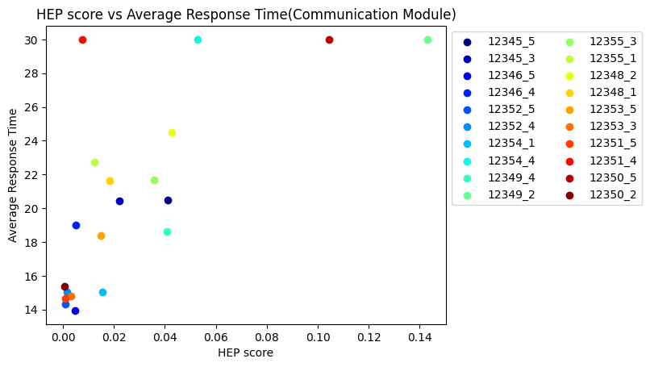

Slide 60
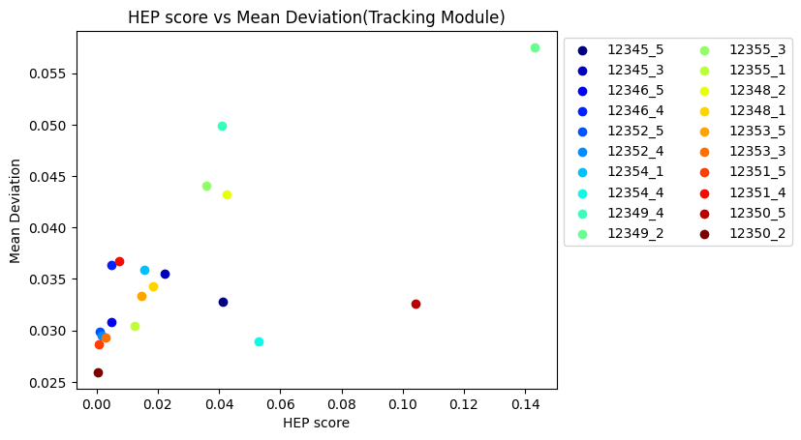

Slide 61
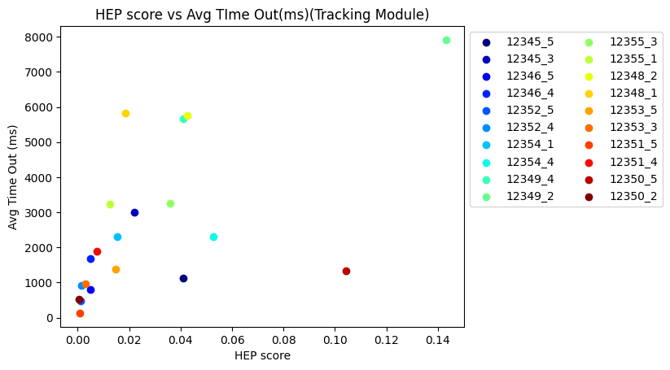

Slide 62
Conclusions
Results show that HEP score and the performance of the subject are related.
Most instances follow this trend, although there are some outliers.
Proposed HRA model using EEG signals can be used to estimate Human Error Probability and hence the Human Reliability.

Slide 63
Future Work
Additional PSFs
Multi-Modal Approach

Slide 64
References:
[1] http://www.facweb.iitkgp.ac.in/~baidurya/dissemination/Chapter%2016%20Reliability.pdf
[2]https://www.nasa.gov/sites/default/files/atoms/files/cognitive_workload_technical_brief_ochmo_06232020.pdf
[3] Shabnam Samima and Monalisa Sarma. “PSPHERE: person specific human error estimation”. In: Journal of Reliable Intelligent Environments 8.2 (2022), pp. 133–164.
[4] https://people.cs.umass.edu/~mcgregor/240S17/lec15.pdf

